Slide 1
DETECTING PHISHING WEBSITE USING MACHINE LEARNING

Slide 2
Presented By :
Ajaykumar Majukar
Nadeem Nakkashi
Darshan Belgaonkar
Guide :
Prof .Savita Bakare

Slide 3
OVERVIEW OF THE PROJECT
Phishing is one of the luring techniques used by phishing artist in the intention of exploiting the personal details of unsuspected users.
Phishing website is a mock website that looks similar in appearance but different in destination.
This project employs Machine-learning technique for modelling the prediction task and supervised learning algorithms namely K-Nearest Neighbor, Support Vector Machine, Decision tree and Random Forest, etc are used for exploring the results.

Slide 4
1.
INTRODUCTION
Let’s start with the definition of the “Phishing”

Slide 5
“fish"
FISH The analogy is of an angler throwing a baited hook out there (the phishing email) and hoping you bite
fishing
“Phreaking"
Phishing
1990s
Phreaking is a slang term coined to describe the activity of a culture of people who study, experiment with, or explore telecommunication systems, such as equipment and systems connected to public telephone networks.
phreak

Slide 6
Phishing is the fraudulent attempt to obtain sensitive information such as usernames, passwords and credit card details by disguising oneself as a trustworthy entity in an electronic communication.

Slide 7
2.
Problem Identification
Why “Phishing” is a Problem To The Society ?

Slide 8
Annual Worldwide Impact $5 billion
Cost Of Repairing the impact is
$6 billion

Slide 9

Challenges To Be Faced
How to determine the best set of features to be used with phishing detection.
How to select the best classification algorithm to be used for phishing detection.
How to integrate multiple classification algorithms for phishing detection and to evaluate such integration.

Slide 10
3.
Literature Survey
Related Work

Slide 11
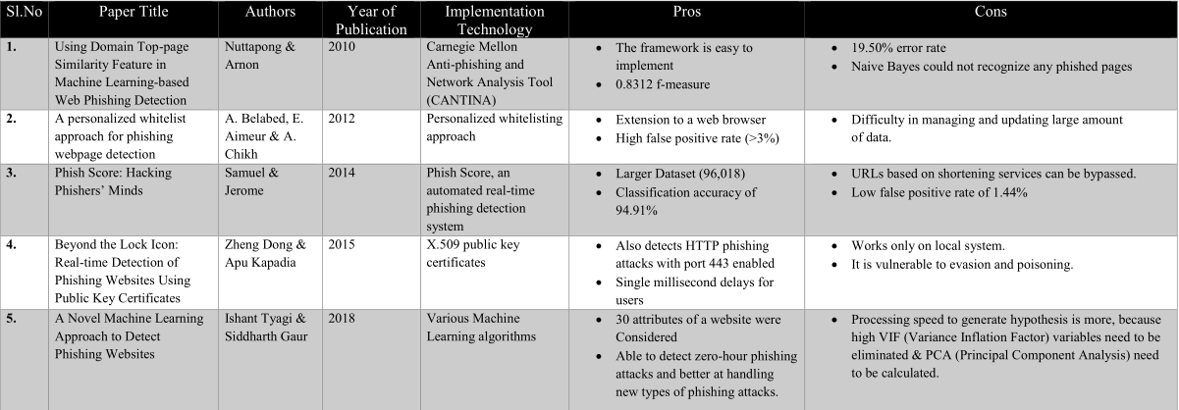

Slide 12
4.
Objectives

Slide 13
Objectives To Be Achieved
To distinguish the phishing websites from the legitimate websites and ensure secure transactions to users.
To carry out an exploratory analysis of the Phishing Websites Data Set and an interpretation of it.
To create a new dataset which has recent websites entries to get a better accuracy.
To determine the best classification algorithm for phishing detection.

Slide 14
5.
DESIGN DETAILS
FlowChart & DataSet

Slide 15
OUR PROCESS IS EASY
Data Pre-processing
Training the model
Evaluating the model and Testing the model

Slide 16
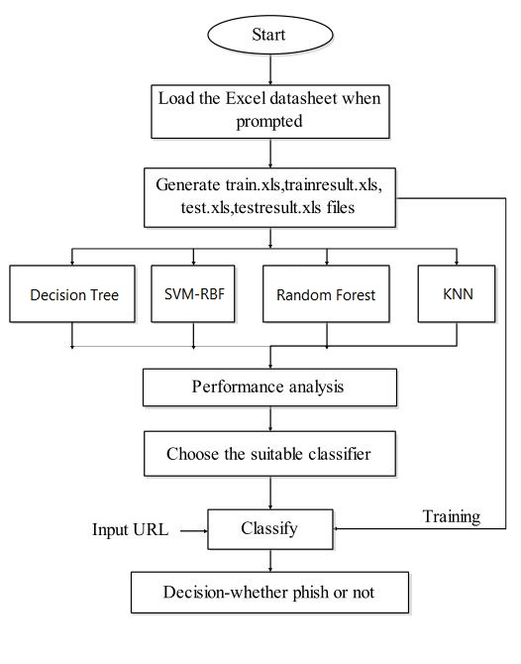

Slide 17
11055
30
90% - 95%
Number of Entires:
Number of Attributes:
Accuracy Using KNN , SVM , Random Forest and Decision Tree

Slide 18
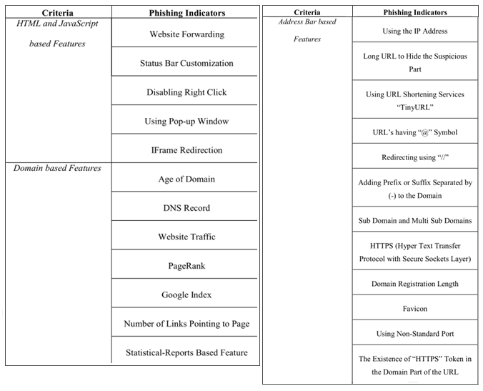
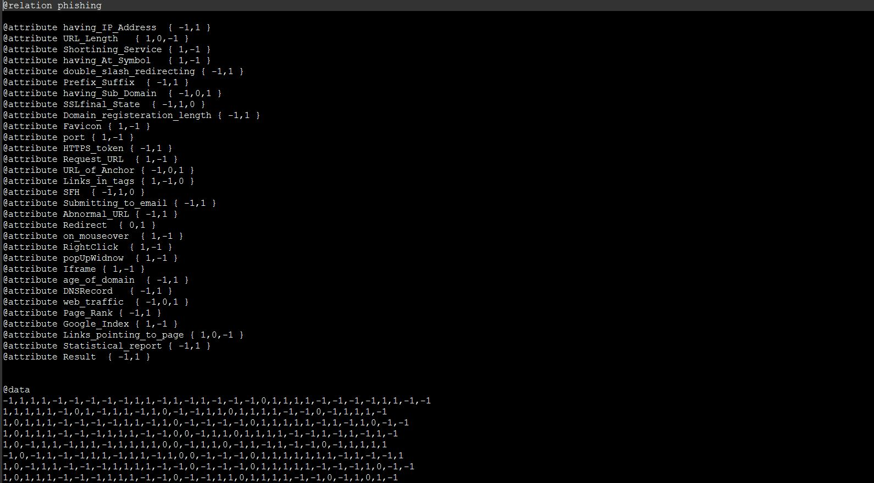
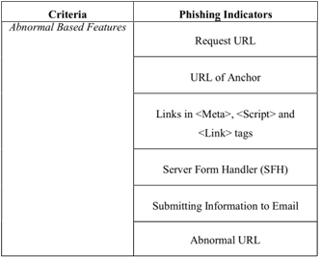

Slide 19
7.
METHODOLOGY

Slide 20
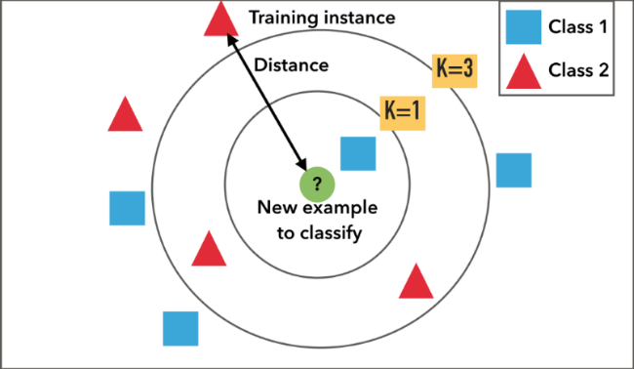
K-Nearest Neighbors Algorithm
KNN algorithm is one of the simplest classification algorithm
KNN is a non-parametric learning algorithm
KNN is also a lazy algorithm which relates to lack of generalization
i.e. KNN keeps all the training data

Slide 21
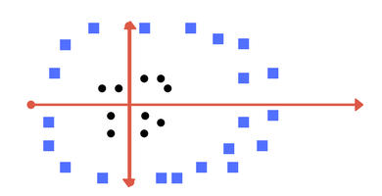
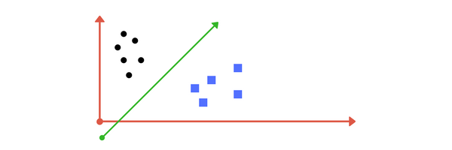
Support Vector Machine Algorithm
Support Vector Machine (SVM) is a discriminative classifier formally defined by a separating hyperplane
Can you draw a separating line in this plane?

Slide 22
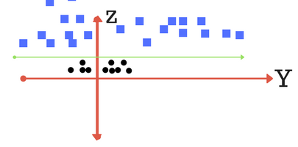
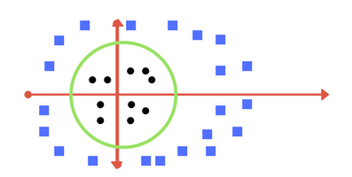
Plot of zy axis. A separation can be made here.
Transforming back to x-y plane, a line transforms to circle
These transformations are called KERNELS.

Slide 23
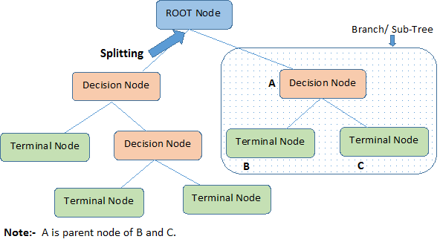
Decision Trees Algorithm
Decision Trees (DTs) are a non-parametric supervised learning method used for classification and regression
Decision trees learn from data to approximate a sine curve with a set of if-then-else decision rules
A decision tree classifier is just like a flowchart diagram with the terminal nodes representing classification outputs/decisions.

Slide 24

Random Forest Algorithm
A random forest is made of many decision trees
Each decision tree in the forest considers a random subset of features when forming questions and only has access to a random set of the training data points.

Slide 25
7.
CONCLUSION & FUTURE SCOPE

Slide 26
LET’S REVIEW PROJECT OUTCOME
The accuracy using
95.20%
K-Nearest Neighbor
94.70%
SVM-RBF
91.94%
Decision Tree
87.74%
Random Forest
Hence, we conclude that K-Nearest Neighbors classifier results best in terms of accuracy among the four classifier algorithms.
FUTURE SCOPE
Additional Features
Certain additional heuristics such as Number of Links Pointing to Page, Google Index, TTL value of the domain can be implemented
Browser Extension
Creating an extension to block the detected phishing website whenever the user clicks on the link

Slide 27

THANKS!
👨 Any questions ?

